Slide 1
Implement CRUD Application with RESTful Web Service and ReactJS

Slide 2
Objectives
Overview of the application
Working with Spring Boot API
Working with ReactJS project
Run the CRUD application

Slide 3
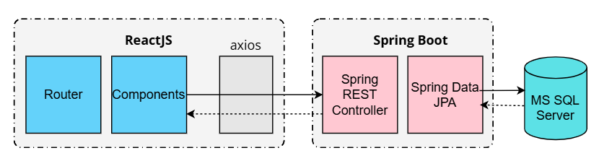
The overview of CRUD Application
Server side: Spring REST API, Spring Data JPA
React Client sends HTTP requests and retrieve HTTP responses using axios, shows data on the components. Use React Router for navigating to pages.
Database MS SQL Server.

Slide 4
Part 1. Working with Spring Boot API project
Notes:
Steps are same with Slide 13

Slide 5
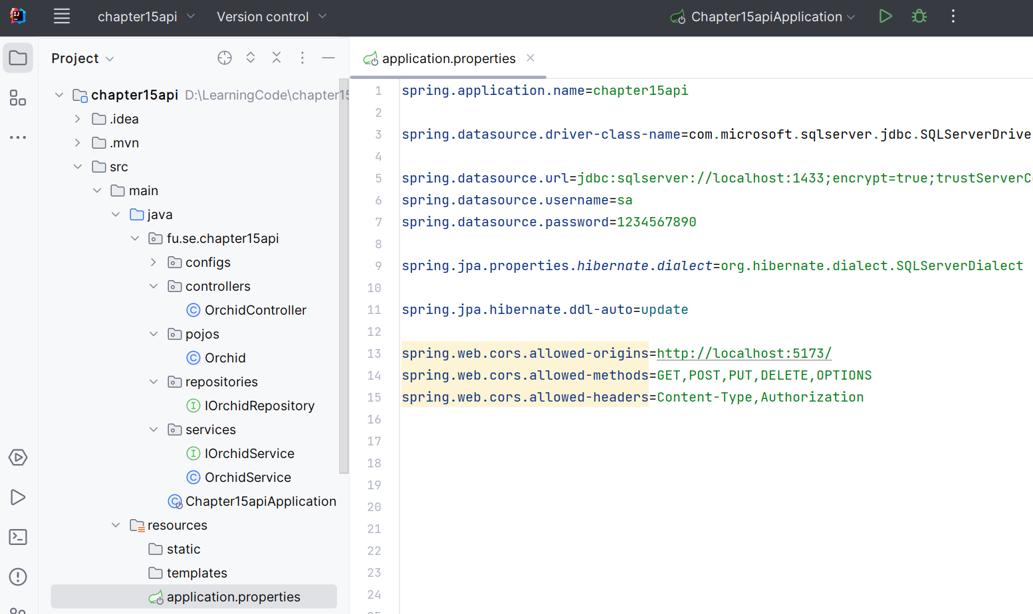
Step 1. Set up Project with IntelliJ IDEA

Slide 6
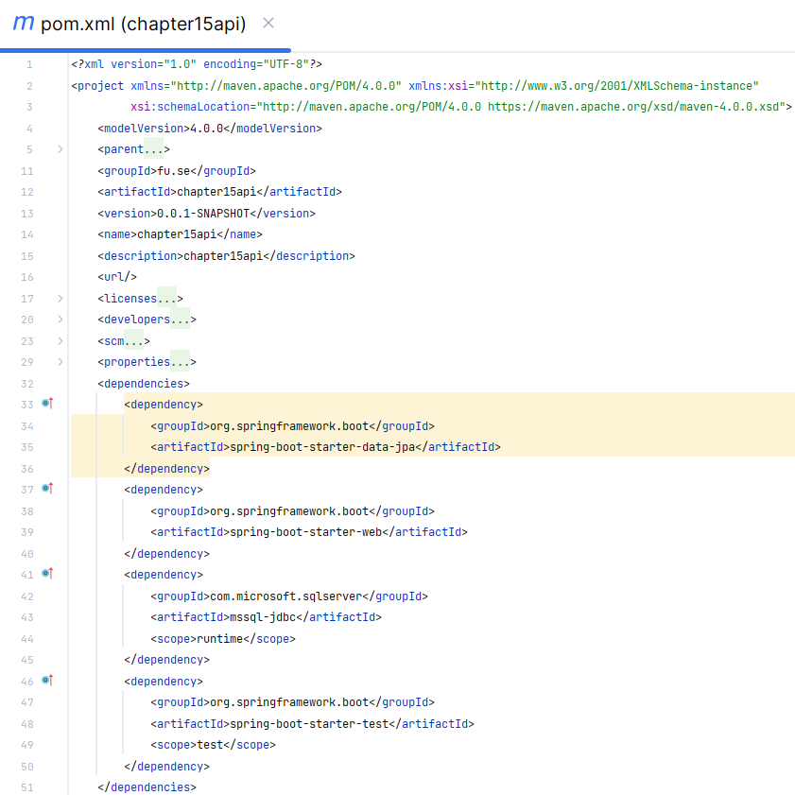
Step 1. Set up Project with IntelliJ IDEA
Dependencies
Spring Web
Spring Data JPA
MS SQL Server

Slide 7
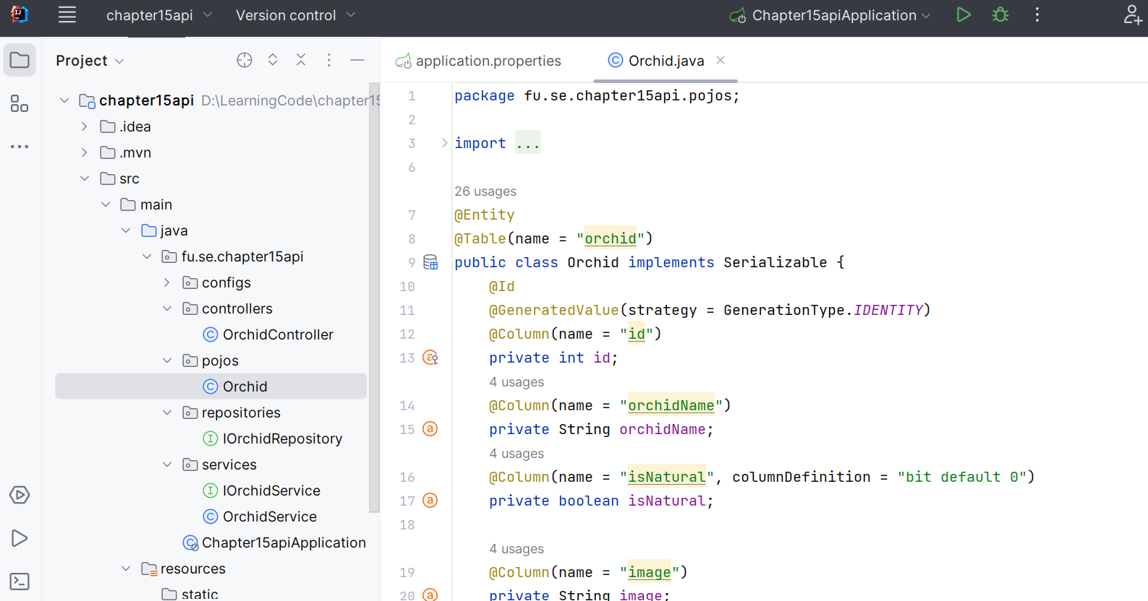
Step 2. Create entity class
@Entity
@Table

Slide 8
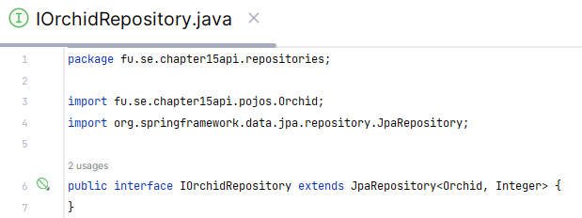
Step 3. Work with Data Access Layer
Create interface, that extends JpaRepository<T,ID>
Interface JpaRepository<T,ID>
Inherits CrudRepository, ListCrudRepository, QueryByExampleExecutor, ListPagingAndSortingRepository, PagingAndSortingRepository,
T getReferenceById(ID id) - Returns a reference to the entity with the given identifier.
<S extends T> List<S> findAll(Example<S> example)
<S extends T>List<S> findAll(Example<S> example, Sort sort)

Slide 9
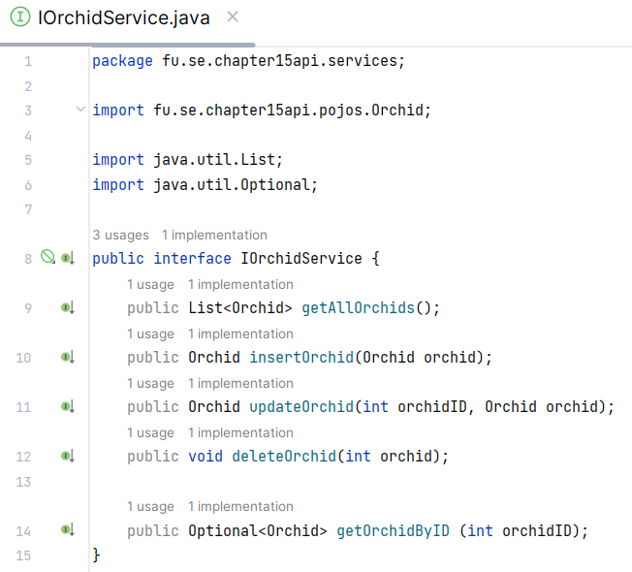
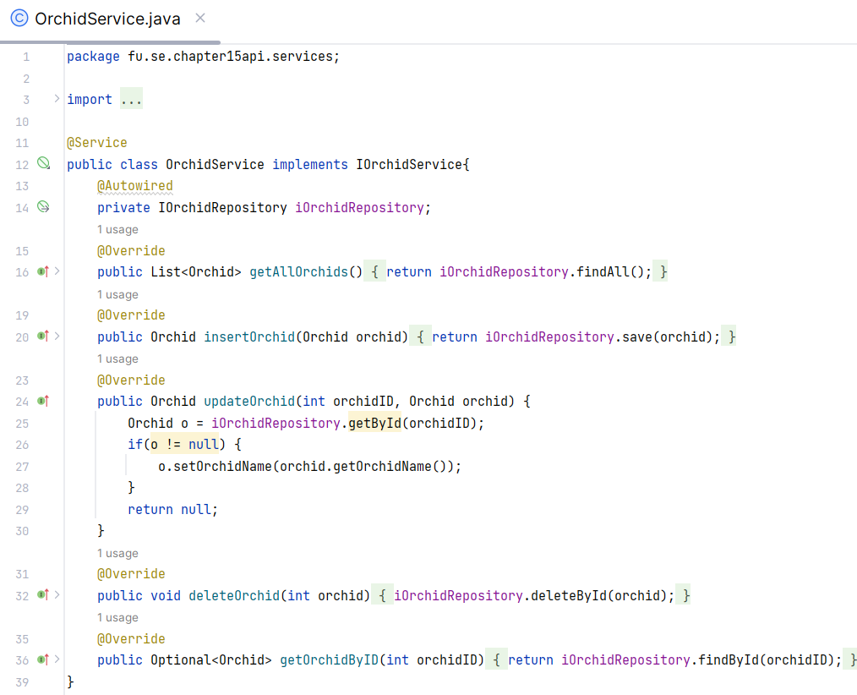
Step 4. Work with Business Logic Layer

Slide 10
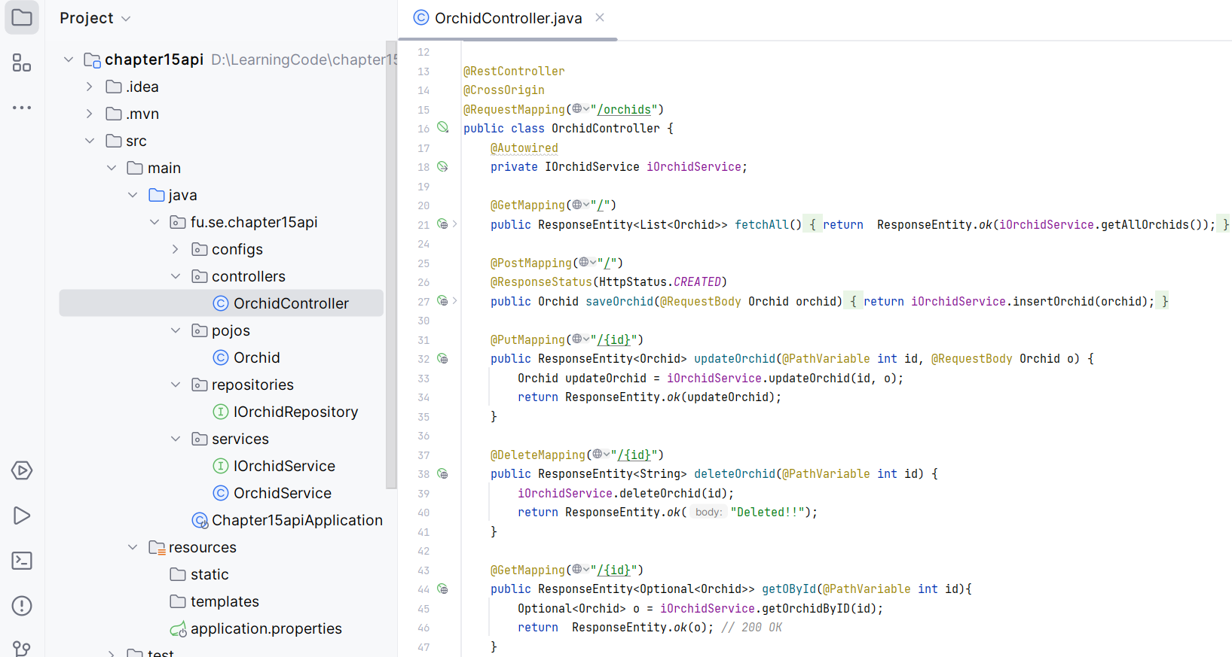
Step 5. Work with REST Controller

Slide 11
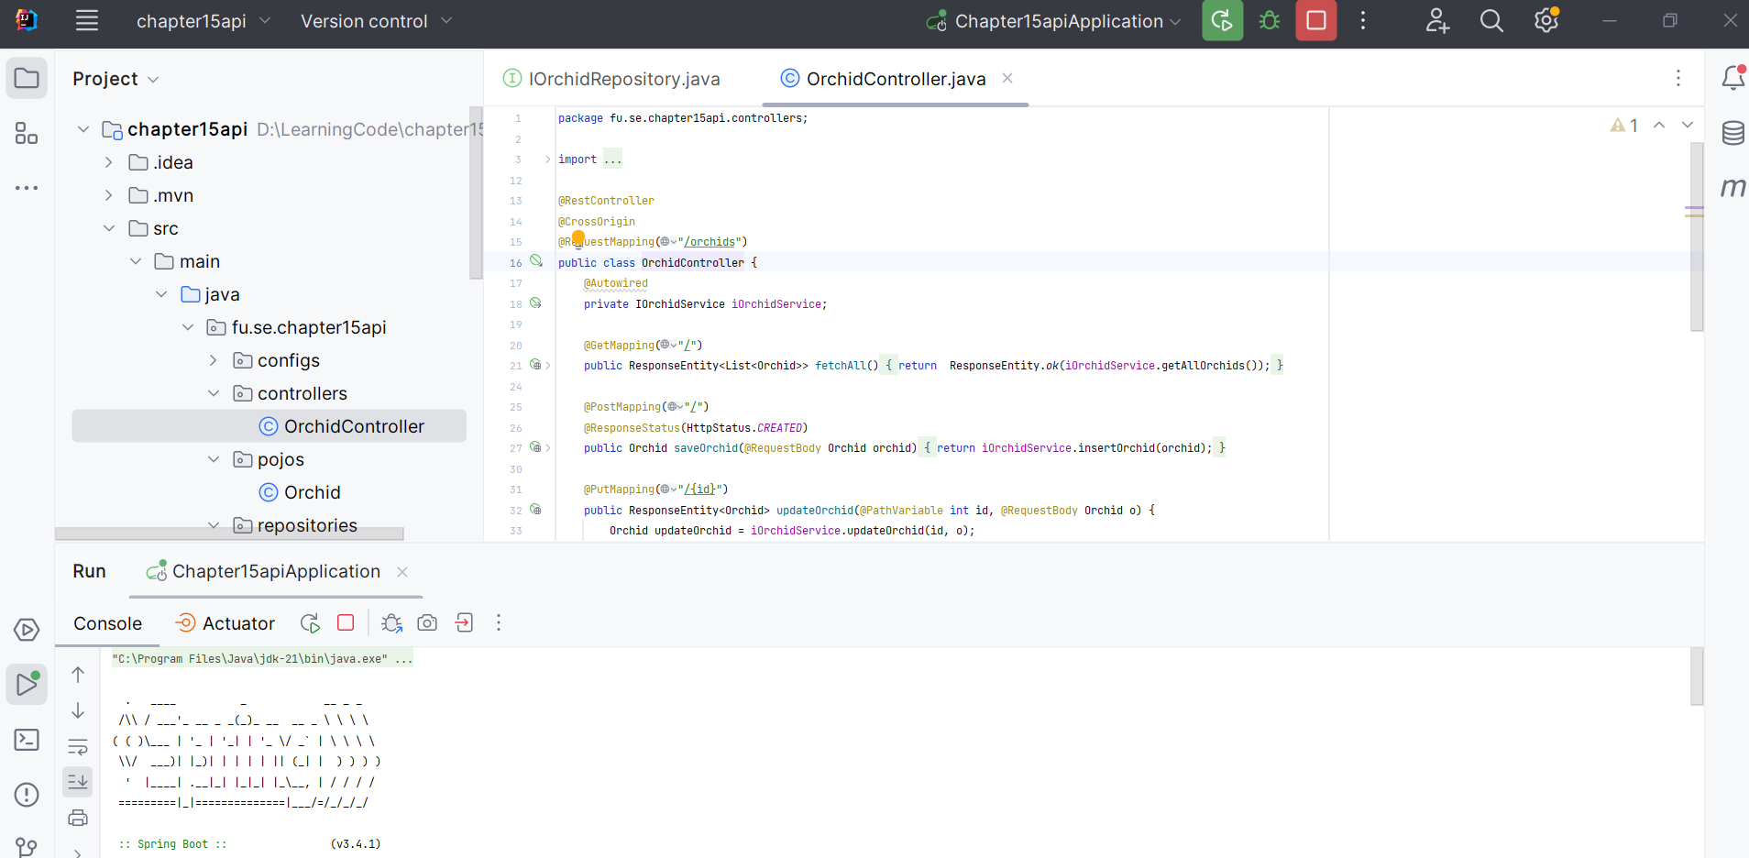
Step 5. Run Spring Boot REST API project

Slide 12
Part 2. Working with ReactJS project

Slide 13
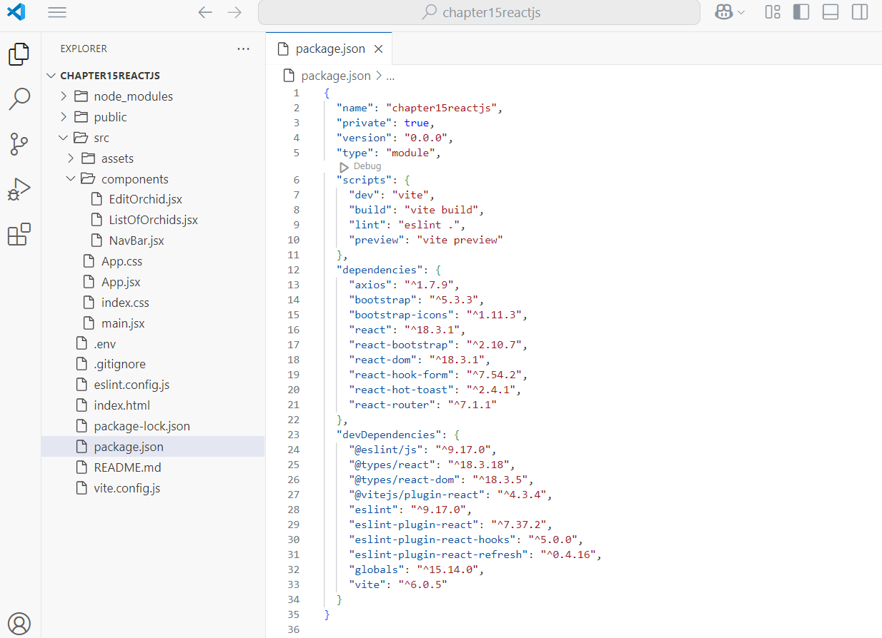
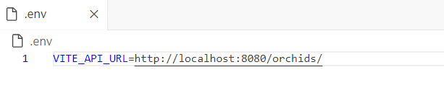
Step 1. Set up the React project with Vite
Open the terminal and run “npm create vite@latest chapter15reactjs”
Choose "React" framework and "JavaScript" variant.
Install dependencies: npm install
Create a text file that contains environment variables

Slide 14
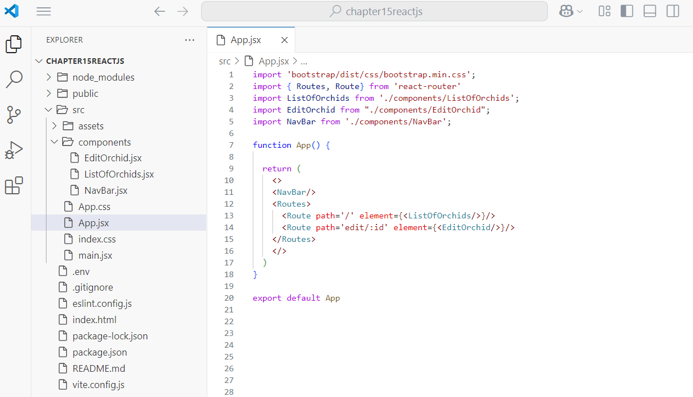
Step 2. Change the root component App.jsx
App.jsx is the root component of React application.
App.jsx acts as the container for all other components and defines the overall structure of user interface.
App.jsx imports and renders other components, creating a hierarchy of components that form the application.

Slide 15
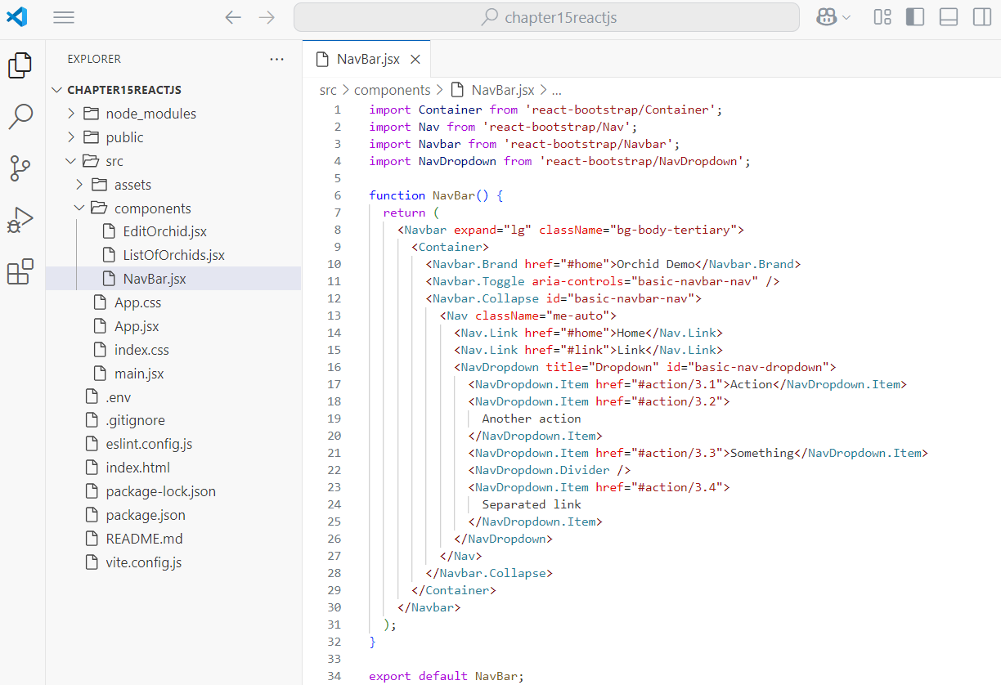
Step 3. Work with navigation bar NavBar.jsx

Slide 16
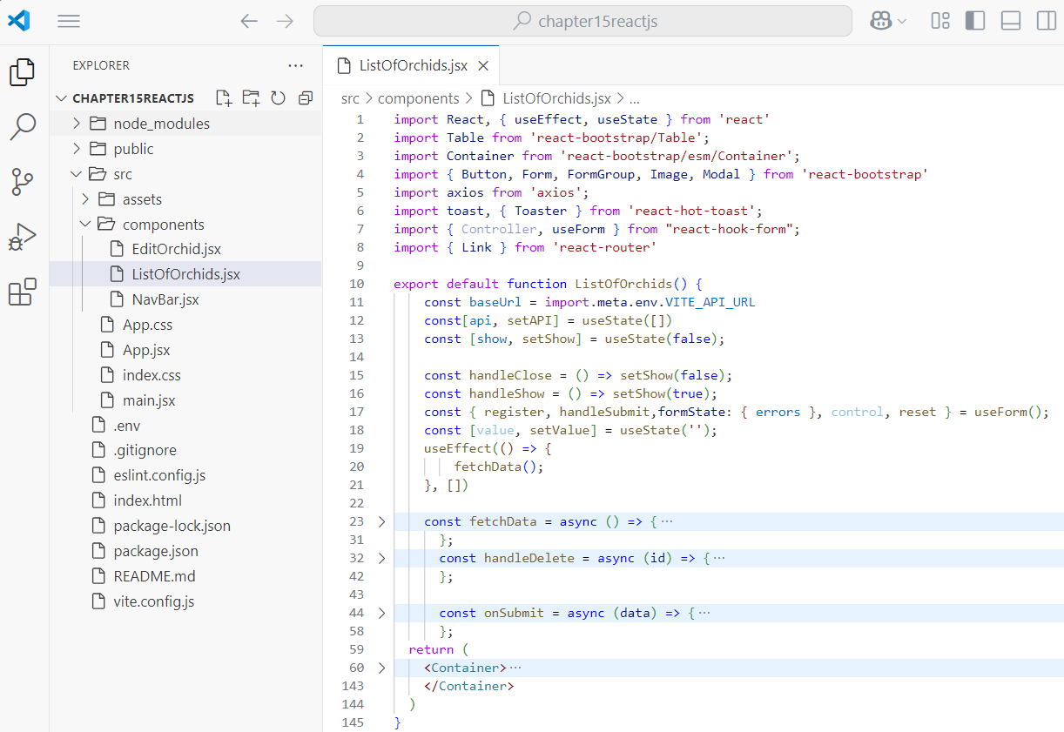
Step 4. Work with ListOfOrchids.jsx - 1

Slide 17
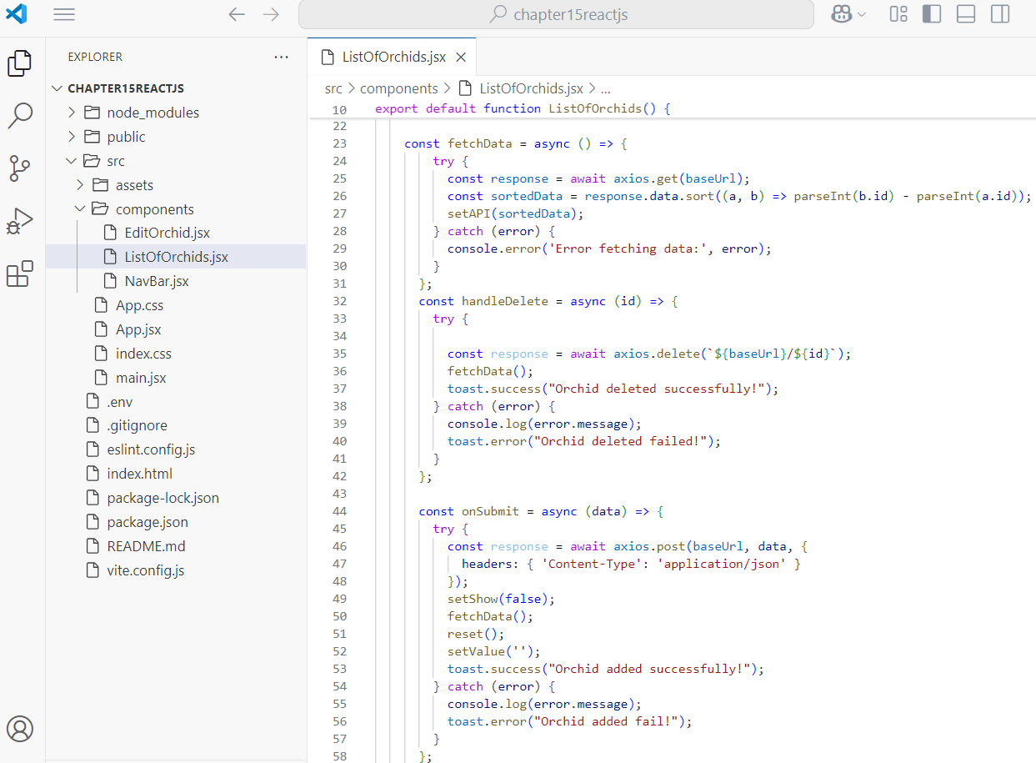
Step 4. Work with ListOfOrchids.jsx - 2

Slide 18
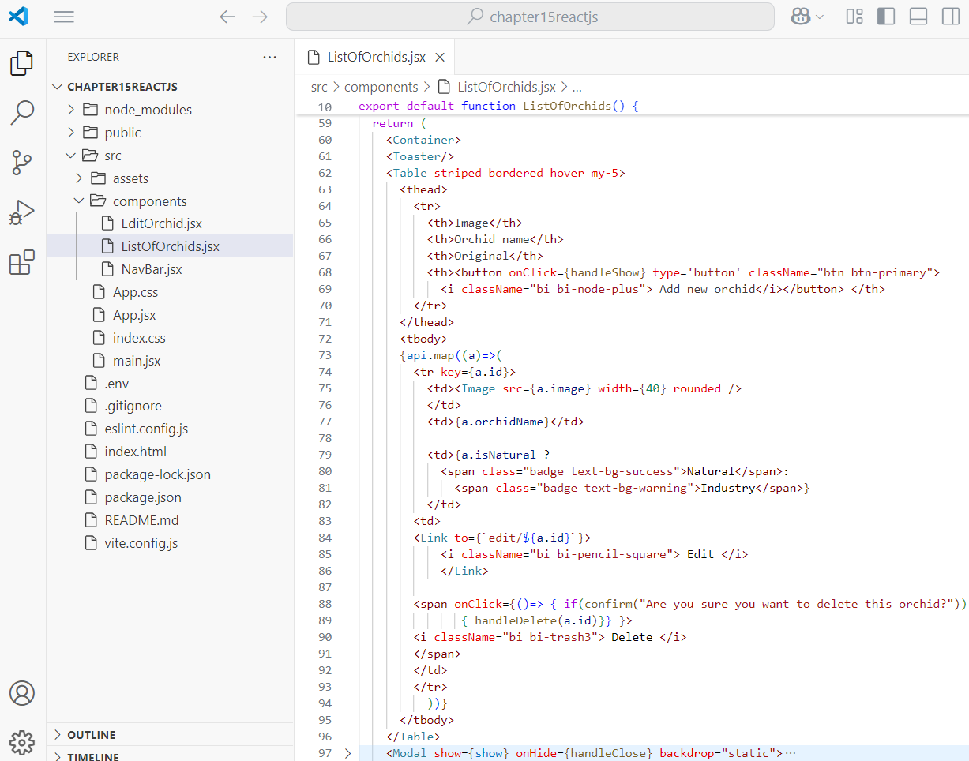
Step 4. Work with ListOfOrchids.jsx - 3

Slide 19
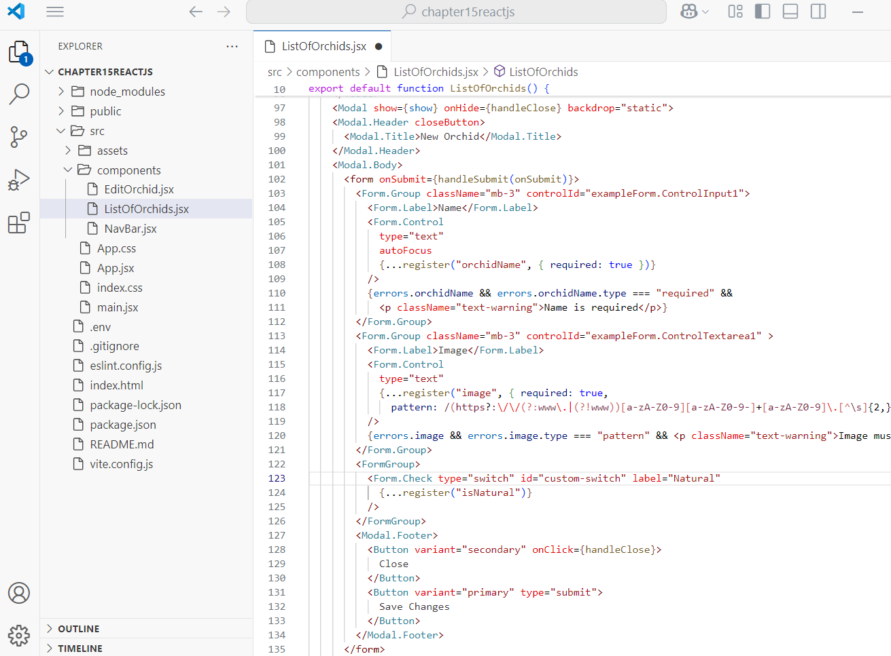
Step 4. Work with ListOfOrchids.jsx - 4
Modal for create a new item

Slide 20
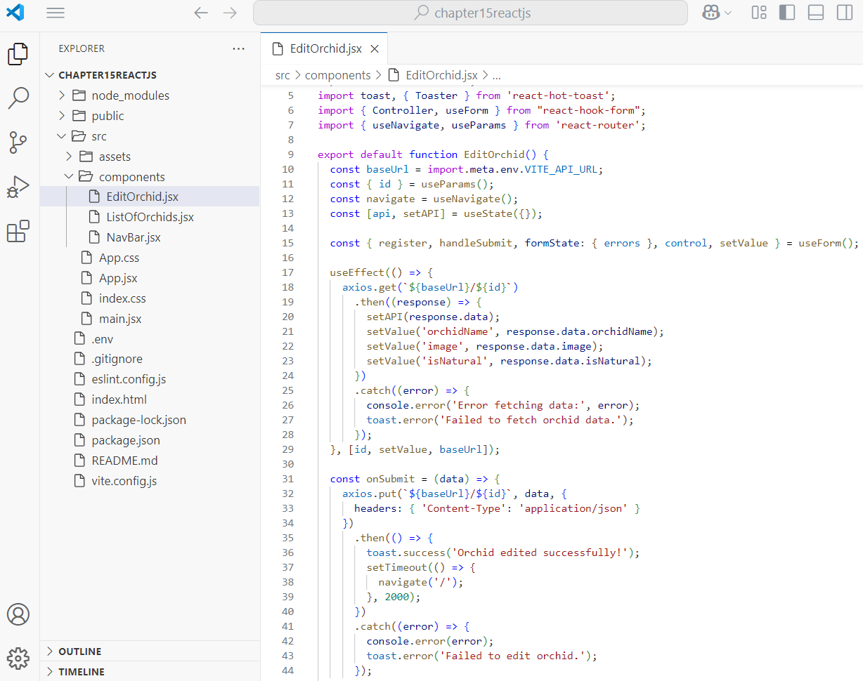
Step 5. Work with EditOrchid.jsx - 1

Slide 21
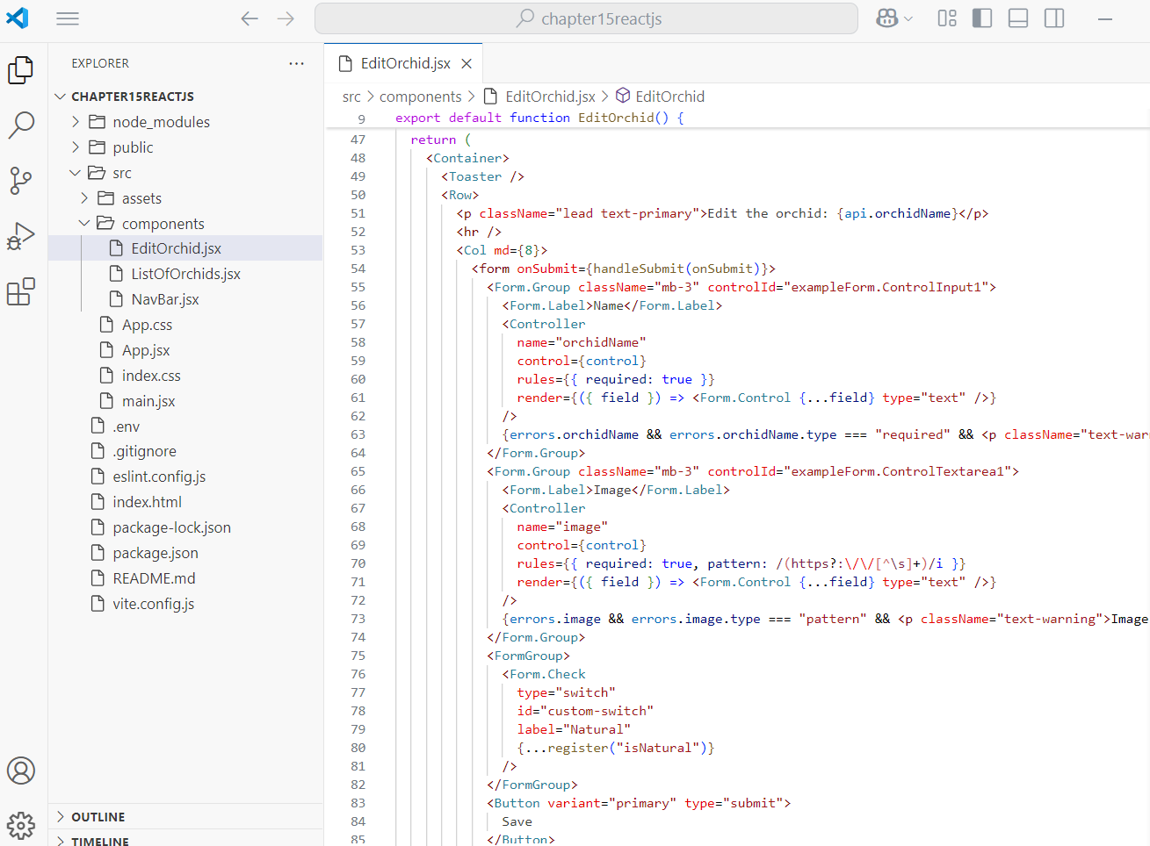
Step 5. Work with EditOrchid.jsx - 2

Slide 22
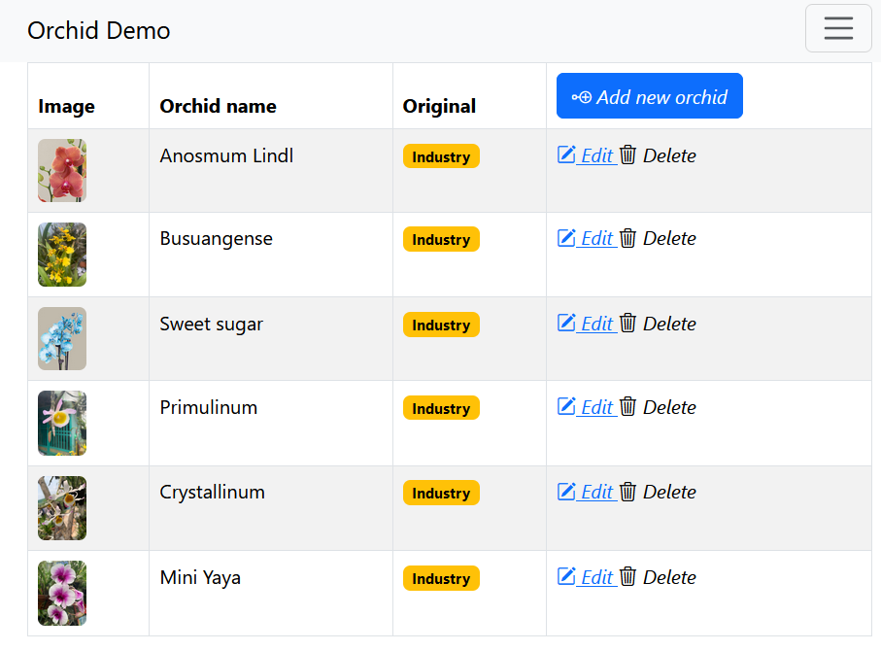
Step 6. Run the ReactJS application
Run the ReactJS application
Start the development server: npm run dev
Open browser to http://localhost:5173/

Slide 23
Summary
Concepts were introduced:
Overview of the application
Working with Spring Boot API
Working with ReactJS project
Run the CRUD application

